Slide 1
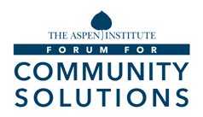
GOYN Equity & Structural Justice Framework
neeraj@trif.in
≤.
NOVEMBER 2022

Slide 2
CONTENTS
01
Introduction and objectives
04
Synthesis of existing GOYN
research and perspectives
02
Draft framework for equity
and structural justice
05
External lessons on applying an
equity and structural justice lens
03
Taking the framework forward
06
Annex: Stakeholder inputs
‹#›

Slide 3
EXECUTIVE SUMMARY
Inspired by the work of the Aspen Forum for Community Solutions - Opportunity Youth Forum, long committed to advancing racial equity and equitable economic opportunities in the United States, GOYN is now developing its own ‘equity and structural justice framework’ to be more systematic, explicit and focused on the underlying root causes in its push towards promoting youth-led equitable change. The development of the framework will involve being more intentional in the work that GOYN already does, and coalescing the GOYN network around a shared understanding, language, values and culture that uplifts diversity in perspectives across its communities.
Conversations with stakeholders similarly reaffirmed the desire for the framework to bring increased focus, greater accountability and common understanding to their work around equity and structural justice. In particular, stakeholders expressed a desire for a clear vision and outcomes that lay out what ‘success’ looks like, alongside indicators that help them to track progress.
GOYN’s framework should work towards a vision focused on equipping and inspiring a growing global network of opportunity youth (OY) to lead the way in advancing sustainable youth livelihoods in their local communities, particularly for youth with least access to opportunity. In the longer-term, this will involve shifting mindsets on OY potential, transforming practices in livelihood sectors, and influencing policies that shape livelihood opportunities. In the shorter-term, this will mean equipping OY to understand, discuss and address issues related to equity and structural justice.
Importantly, the framework will be accompanied by guiding questions to help GOYN and its partners understand how they will contribute to this change in a contextualized way that centers on OY assets, experiences and assets. Specifically, these will help GOYN and partners to define who they are, what they do, and how they operate in service of the desired outcomes and vision.
To take this forward, GOYN can start to socialize and refine the framework before sharing and testing it more widely with its partners. Following this, they can pilot specific aspects of the framework both at the GOYN level and in at least one community, and use the learnings and evidence generated to refine its approach ahead of scaling the pilot and integrating it with parallel efforts.

Slide 4
Introduction and objectives
CHAPTER 01
CONTEXT
‹#›

Slide 5
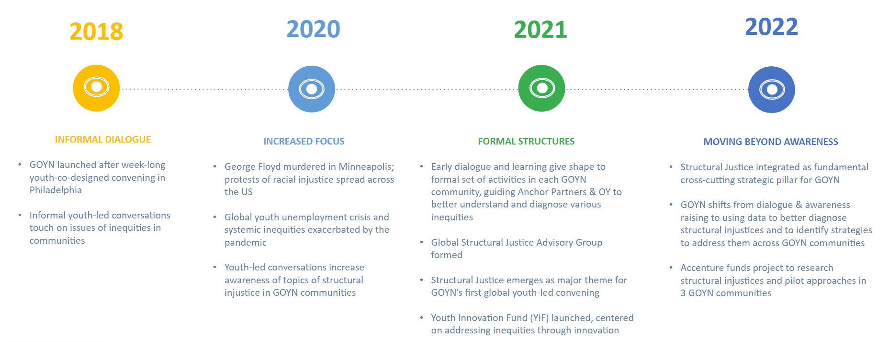
Since 2018, we have been on a journey to more intently embed equity and structural justice in our work…
BACKGROUND
As part of our efforts to move from dialogue to action, we are fleshing out a global equity and structural justice framework to more intently combat structural inequities in our work

Slide 6
…and we are now fleshing out a framework to help us move from dialogue to action
INTRODUCTION & OBJECTIVES
WHY we are doing this
Young people that we work with asked us to start thinking more intentionally about how we focus on and advance issues of equity and structural justice in our work
In this way, the framework is an opportunity to be more systematic, explicit and accountable in our push towards promoting equitable youth livelihoods
This will involve applying a deeper and more intentional focus on the root causes that enforce and perpetuate issues of inequity and injustice within our work…
…as well as coalescing around a shared understanding, language, values and culture focused on equity, while embracing and uplifting diversity of perspective across our communities
WHAT this will look like
The framework will consist of three components…
VISION | Our overall goal with respect to achieving equitable youth livelihoods through youth-led change
OUTCOMES | The longer- and shorter-term outcomes that we are working towards that will improve economic mobility and livelihood options for OY with least access to opportunity
HOW WE WILL CONTRIBUTE | Defining who we are, what we do, and how we operate in service of our desired outcomes and vision
…accompanied by a set of guiding questions that inform how we should contribute towards our vision and how partners can contextualize this work in their communities, centering on OY assets and perspectives

Slide 7
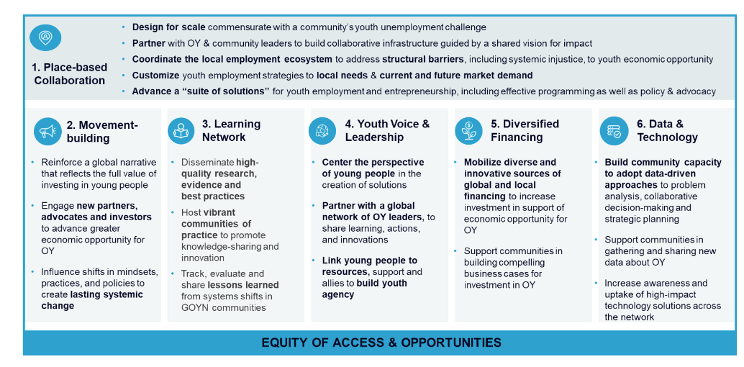
The framework will deep dive on the ‘equity of access & opportunities’ lens, cutting across all of our strategic pillars
INTRODUCTION & OBJECTIVES
GOYN strategic pillars
The following sections put forth a perspective on how GOYN could advance equity of access & opportunities

Slide 8
Draft framework for equity and structural justice
CHAPTER 02
FRAMEWORK
‹#›

Slide 9
PURPOSE
The framework can provide greater direction and clarity in applying an equity and structural justice lens
Partners and members would benefit from a framework that creates…
…and that is designed in a way that is:
INCREASED FOCUS | Building a clear vision, goals and outcomes around equity and structural justice that provide focus and direction to the work of GOYN and members
GREATER ACCOUNTABILITY | Helping GOYN and partners understand what success looks like, and whether they are on track towards achieving it
COMMON TERMINOLOGY | Aligning the organization around a consistent understanding of equity and structural justice, using plain language to which all partners, communities and individuals are able to relate
RELEVANT | Can be applied across all current and future GOYN communities, whereby individuals across all backgrounds can see themselves in it
NUANCED | Has sufficient flexibility for different communities to contextualize the framework to the issues most pressing to disadvantaged OY
ADAPTIVE | Enables GOYN members to consider any dimension of diversity and their intersections in its work
ACTIONABLE | Helps different communities identify concrete activities or actions to address the most pertinent barriers
We are already doing a lot of these things [related to equity and structural justice], but there’s room to be more intentional about what we do and define what the goal posts are that we’re driving towards
QUOTES FROM INTERVIEWS:
I would like to see a framework that's concise and able to distil all the different aspects of equity without sacrificing the place-based lens
Source: Dalberg interviews with key partners
‹#›

Slide 10
GOYN and its members aim to promote equitable youth livelihoods, eliminating gaps in access to opportunity
VISION FOR SUCCESS
What is our
overall VISION?
Equipping and inspiring a growing global network of opportunity youth (OY) to lead the way in advancing sustainable youth livelihoods in their local communities, particularly for youth with least access to opportunity
How can GOYN and partners CONTRIBUTE to this change?
What changes are required to achieve this in the…
…LONGER-TERM?
Shifting mindsets on OY potential
All OY embrace their identities, and those proximate to OY or positioned to shape their livelihood outcomes value the unique assets and contribution potential that OY bring
Transforming the practices in livelihood sectors
The way in which practices across livelihood pathways are conducted is informed by and most responsive to the needs of OY with least access to opportunity
Influencing policies that shape livelihood opportunities
Key decision-makers have shifted policies in ways that increasingly allocate financial resources towards livelihood opportunities for OY with least access to opportunity
WHO WE ARE:
Our beliefs, values, and culture
WHAT WE DO: Our activities, approaches and partnerships
OY ASSETS & PERSPECTIVES
HOW WE OPERATE:
Our processes, systems, and structures ​
…SHORTER-TERM?
All OY, especially those with least access to opportunity, and those working with OY are equipped to understand, discuss, and address issues related to equity and structural justice
‹#›

Slide 11
OY ASSETS AND PERSPECTIVES | Identifying our target population of OY and their unique assets, perspectives and experiences
KEY QUESTION
Based on the data and evidence available, which specific population of OY should anchor partners focus on in their community?
What are the unique assets, perspectives and experiences that this target population brings to bear?
WHO WE ARE:
Our beliefs, values, and culture
WHAT SOLVING THIS WILL INVOLVE
1. Guiding questions for anchor partners to identify the target population
2. Guiding questions for anchor partners
to ask OY
WHAT WE DO: Our activities, approaches and partnerships
Which social groups have the lowest participation and/or sustenance rates of education and employment?
Which social groups are subject to the most profound individual, community and ecosystem level barriers in accessing livelihood options?
Which social groups face the most negative narratives in their communities, local media and society?
What historical events, policies and generational forces have perpetuated barriers and narratives for specific social groups today?
What do you see as your greatest strength?
What makes you feel like you are valued, treated fairly, and belong?
What stories have you heard about people like you and what they can achieve?
What do you never want to see, hear, or have happen again at school or in a placement?
What limitations are there for how you can talk about issues of structural justice?
What do you want others to know and do to make it easier for you to engage in OY programs?
OY ASSETS & PERSPECTIVES
HOW WE OPERATE:
Our processes, systems, and structures ​
KEY TAKEAWAY
Centring on OY right from the beginning of our work allows us to ensure that what we do and how we show up in each of our communities
incorporates their unique aspirations, lived experiences, assets and perspectives
‹#›

Slide 12
WHO WE ARE | Aligning on our shared beliefs, values, culture and understanding around issues of equity and structural justice
KEY QUESTION
How do we ensure that our organizational beliefs, values, culture and shared understanding around issues of equity and structural justice are consistent with our goals on promoting equitable youth livelihoods?
WHO WE ARE:
Our beliefs, values, and culture
WHAT SOLVING THIS WILL INVOLVE
Guiding questions for GOYN to consider
WHAT WE DO: Our activities, approaches and partnerships
Have we articulated specific values relating to our work on equity and structural justice?
Have we developed a shared language and understanding of equity and structural justice as an organization, ensuring that the language:
Is accessible and adaptable to specific community contexts?
Uses an asset-based lens?
Explicitly acknowledges intersectionality of experience?
Is unbiased and does not perpetuate unfavorable power dynamics (e.g., uses words like “partner organizations, rather than beneficiaries)?
Is incorporated explicitly in our strategy and goals – both internally and externally?
Do we openly acknowledge power dynamics at play – including our own personal prejudices and biases?
Is there diversity and representation across our leadership and team structures?
Do our recruiting, pay and other people-related practices actively seek to improve outcomes for those with less opportunity?
OY ASSETS & PERSPECTIVES
HOW WE OPERATE:
Our processes, systems, and structures ​
‹#›

Slide 13
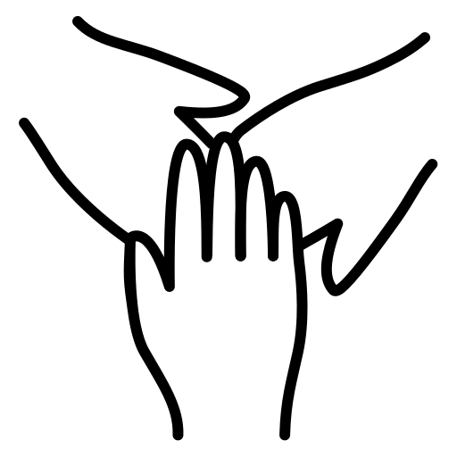
WHO WE ARE | Illustrative glossary of shared terminology that GOYN can adapt and refine
Term
Illustrative GOYN definition
BELONGING
The feeling of security and support when there is a sense of acceptance, inclusion, and identity for a member of a certain group.
Each individual or group of people is given the same resources or opportunities (versus equity, which recognizes that each person has different circumstances and allocates the exact resources and opportunities needed to reach an equal outcome)
EQUALITY
All individuals, regardless of their identity or social group, have an equal opportunity to experience a meaningful livelihood. In our local contexts, this will involve reforming the hierarchies, structures, policies, systems and practices that perpetuate disparities for specific identities or social groups.
EQUITY
INTERSECTIONALITY
The complex, cumulative forms of oppression and discrimination that result from the overlap of an individual’s various social identities
POWER
The ability of individuals and communities to shape their own destinies through agency over assets; ideas, norms and narratives; practices; and laws and policies
STRUCTURAL
BARRIER
The individual-, community-, and ecosystem- level obstacles that affect specific social groups disproportionately and perpetuate or maintain disparities in outcomes
Injustice replicated by a system of rules that persistently tries to disempower members of particular social groups.¹ Such groups may be defined by racial or ethnic identity; gender identity; sexual orientation; religious affiliation; physical ability; social class or caste; or other regionally imposed differentiating factors that create barriers to opportunity in all aspect of life and livelihoods²
STRUCTURAL
INJUSTICE
Addressing the root causes, rather that the symptoms or proximate causes, of the issues that impede individuals from accessing and engaging with livelihood options
SYSTEMS CHANGE
Sources: 1. Jugov, T. and Ypi, L. (2019), Structural Injustice, Epistemic Opacity, and the Responsibilities of the Oppressed. J Soc Philos, 50: 7-27. doi:10.1111/josp.12268”
2. GOYN Youth Advisory Groups, September 2020 All-YAG Meeting
‹#›

Slide 14
WHAT WE DO | Identifying which activities we should pursue to promote equitable youth livelihoods in communities
KEY QUESTION
What specific combination of activities should anchor partners focus on to pave the way for equitable youth livelihoods in their community?
WHO WE ARE:
Our beliefs, values, and culture
WHAT SOLVING THIS WILL INVOLVE
Guiding questions for anchor partners to consider
WHAT WE DO: Our activities, approaches and partnerships
Do the activities focus on the target population in their community, i.e., OY that sit at the intersection of multiple marginalized identities?
Do the activities enable OY and those proximate to OY to understand, discuss and address issues of inequity and structural injustice
Do the activities equip OY, OY ambassadors and other local decision-makers to own the change?
Are we working with or through local actors that are either led by or have strong representation of target OY?
OY ASSETS & PERSPECTIVES
HOW WE OPERATE:
Our processes, systems, and structures ​
‹#›

Slide 15
WHAT WE DO | Illustrative long-list of interventions that anchor partners can select from
Illustrative interventions may include*:
Creating ‘discovery’ spaces (e.g., street plays, workshops, flash mobs) for OY and those working with OY
Analyzing existing research on livelihood outcomes and barriers facing OY with least access to opportunity
Commissioning new research that uses disaggregated data to more deeply understand the barriers faced by different social groups and identify those with least access to livelihood opportunities
Mapping the ecosystem of actors, assets, and initiatives focused on improving livelihood outcomes of OY with least access to opportunity – identifying who could be the ‘doers’ and ‘supporters’ once GOYN/ partners step away
Testing new solutions targeted at OY with least access to opportunity, and capturing learnings from experimentation
Opening up communication channels (e.g., local forums, convenings) for OY with least access to opportunity to share their perspectives
Training and counselling OY and those proximate to OY on speaking to issues of equity and structural injustice
Creating spaces (e.g., workshops) that support OY, employers, education practitioners and financial institutions in discussing these issues – respecting when certain topics may be off-limits or taboo in specific community contexts
UNDERSTAND
DISCUSS
Funding and/or running advocacy and awareness/sensitization campaigns, grounded in data-based evidence on the challenges that need to be addressed
Influencing policy and translating it into action
Developing the business case and tools for employers to engage with OY
Building the capacity of local community-based organizations, civil society, and youth leaders
ADDRESS
*If anchor partners identify additional interventions (not included in the above list) within their contexts that would drive long-term systemic change for OY with least access to opportunity, those should be considered if they meet the criteria on the following page.
‹#›
Notes:
Most of our communities are engaged in some form in these activities

Slide 16
HOW WE OPERATE | Ensuring that our internal processes and systems set us up to support this change
KEY QUESTION
How do we ensure that our internal processes, systems and structures reflect and advance our equity goals?
WHAT SOLVING THIS WILL INVOLVE
WHO WE ARE:
Our beliefs, values, and culture
Guiding questions for GOYN to consider
Do we screen potential partners or grantees based on equity and structural justice considerations?
Do we have mechanisms for leadership & staff accountability on equity & structural justice issues?
Do we have MEL practices that facilitate improvement of funding processes and improved outcomes for OY with least access to opportunity? For example, in terms of the:
DESIGN PROCESS: Do we create opportunities for anchor partners and OY to participate and lead in the design of MEL?
DATA: Do we (i) align with our partners on the qualitative and quantitative datapoints to be collected, and (ii) fund our partners to collect disaggregated data in order to identify, analyze, discuss and address differences in experiences and outcomes by social identity marker?
METRICS: Do we have a set of metrics that can be adapted or tailored to partners’ MEL systems and that measure progress against equity-related outcomes for change?
FEEDBACK: Do we have mechanisms to collate, track and respond to (anonymous) feedback from partners, OY and those proximate to OY – particularly to assess whether the process is being executed in equitable and inclusive ways?
LEARNING: Do we report back progress to our partners and OY, both to encourage learning across the network and to let them know how their input was or was not used in decisions?
WHAT WE DO: Our activities, approaches and partnerships
OY ASSETS & PERSPECTIVES
HOW WE OPERATE:
Our processes, systems, and structures ​
‹#›

Slide 17
HOW WE OPERATE | Illustrative high-level indicators that GOYN and anchor partners can track
Overall outcomes we are working towards
Indicative metrics to track these outcomes
Target OY understand the structural barriers inhibiting them from accessing and engaging with livelihood opportunities, and their unique contribution potential in pursuing livelihood options
Target OY explicitly discuss and build awareness of the barriers with employers, education practitioners and other relevant actors who have the ability to influence youth livelihood outcomes
Target OY address (in partnership with local actors, as relevant) the root cause of these barriers
Number of workshops held with target OY population and those proximate to them to surface barriers to opportunity
SHORTER-TERM
Number of training and/or counselling sessions held to support and prepare target OY in discussing these issues
Number of local employers engaged that have opened up specific opportunities for target OY population
Shifting mindsets: All OY embrace their identities, and those proximate to OY or positioned to shape their livelihood outcomes value the unique assets and contribution potential that OY bring
Transforming practices: The way in which practices across livelihood pathways are conducted is informed by and most responsive to the needs of OY with least access to opportunity
Influencing policy change: Key decision-makers have shifted policies in ways that increasingly allocate financial resources towards livelihood opportunities for OY with least access to opportunity
Percentage of target OY that attended workshops and are more able to recognize their unique assets and potential
Percentage of employers that understand and respond to the business case for employing target OY population
LONGER-TERM
Percentage of target OY that feel equipped with the tools, networks and connections to influence local policy change
‹#›

Slide 18
Taking the framework forward
CHAPTER 03
WHAT’S NEXT
‹#›

Slide 19
GOYN should begin by socializing and refining the framework, before piloting after the Bogotá convening
NEXT STEPS
SHARE AT BOGOTÁ CONVENING (end-November)
SHARE draft framework with both internal and global audiences, soliciting reactions and feedback
LEARN how young people and anchor partners would like to further adapt and flesh this out
INCORPORATE learnings and feedback from internal sessions and global partners
SCALE AND INTEGRATE
(2024 and beyond)
SCALE pilot to all GOYN communities and across all components of framework
IDENTIFY additional global organizations with whom to partner and scale efforts
INTEGRATE refined framework with parallel efforts (e.g., global narrative change work, equity leadership program) and broader GOYN strategy
SHARE evidence and lessons continually with internal and external audiences
01.
03.
SOCIALIZE AND REFINE
(next two months)
INTERVIEW anchor partners to gather feedback and test how the framework can be applied and adapted to their contexts
WORK with SJAG to iterate on the framework language / contents
PLAN socialization approach, developing key messages to build support among different audiences (global partners, anchor partners, young people) and potentially appointing internal champions (e.g., YAG or SJAG members) to support efforts
PILOT, TRACK, LEARN AND
ITERATE (over 2023)
PILOT the ‘OY assets and perspectives’ component in at least one community, as well as at least one guiding principle at the GOYN level
DEVELOP AND TRACK initial metrics against equity-related outcomes in line with framework
LEARN and iterate on framework based on continuous feedback and outcome-tracking
SHARE initial data (disaggregated where possible) and lessons in key internal and external platforms (e.g., website)
02.
04.
‹#›

Slide 20
Existing GOYN research and perspectives
CHAPTER 04
SYNTHESIS
‹#›

Slide 21
GOYN and its members typically view ‘structural injustice’ in terms of the disempowerment of specific social groups
DEFINITIONS
GOYN has an overarching definition for ‘structural injustice’…
…with partners customizing their own definitions within this
This includes applying the lens of:
Structural injustice is injustice replicated by a system of rules that persistently tries to disempower members of particular social groups.¹
Such groups may be defined by racial or ethnic identity; gender identity; sexual orientation; religious affiliation; physical ability; social class or caste; or other regionally imposed differentiating factors that create barriers to opportunity in all aspect of life and livelihoods²
Discrimination based on social identity markers e.g., race, gender, caste
The forces & structures shaping the challenges that groups of those identities face i.e., economic, social, political, cultural, geographical, intergenerational
‘Social’ injustices rather than ‘structural’ e.g., in Sao Paulo’s case
Power imbalances
Source: GOYN’s definition for structural injustice sourced from “GOYN Communities and Structural Justice at a Glance” document, which includes the following references:
1. Jugov, T. and Ypi, L. (2019), Structural Injustice, Epistemic Opacity, and the Responsibilities of the Oppressed. J Soc Philos, 50: 7-27. doi:10.1111/josp.12268”
2. GOYN Youth Advisory Groups, September 2020 All-YAG Meeting

Slide 22
For example, anchor partners have identified the primary social identity markers that result in specific groups facing injustices
WHO IS AFFECTED
Primary social identity markers that result in injustices by community, as identified by anchor partners
 | Latin America |  |  | Africa |  |  | India
 | Bogotá | Sao Paulo | Mexico City | Mombasa | eThekwini | Thies | Pune | Ramgarh | Barwani
Gender
Race/ ethnicity
LGBTQIA+
Religion
Physical ability
Social class or caste
Language
Migrant status
Political beliefs
Region/ residence
Court-involved
HIV/AIDs status
Given the breadth of structural injustices that deeply affect OY across communities, the framework will need to be able to adapt to contextual specificities around particular identity markers
Source: GOYN, “GOYN Communities and Structural Justice at a Glance”

Slide 23
These injustices are caused by an entire complex of underlying individual-, community- and ecosystem-level factors
WHY THEY ARE AFFECTED
Synthesis of barriers identified by anchor partners and young people
Individual-level barriers include:
Behaviours, attitudes and mindsets of disadvantaged OY
Lack of knowledge and / or skills
Community-level barriers cover family, school, neighbourhood, and workplace environments, and include:
Discrimination, harassment and safety
Societal roles and expectations
Housing instability
Intergenerational poverty and immobility
Individual
Community
Ecosystem-level barriers cover the political, socio-economic and geographical structures, and include:
Education and employment policies
Income inequality
Lack of access to employment & education opportunities
Property and other institutional rights
Ecosystem
Driving structural change will require understanding, linking together and navigating intersecting barriers across all levels
Sources: Research by anchor partners; interview & workshop with anchor partners; group session with young people; presentations from the GOYN Equity Summit in 2021

Slide 24
These barriers manifest in various ways from the start of disadvantaged OY’s education journey…
Education
HOW THEY ARE AFFECTED
Employment
Barriers along the education pathway
Illustrative examples
Confidence: Low confidence and feeling of being ‘unworthy’ of quality education
Documentation: Lack of ID limits access to education and scholarship opportunities
Male children in Ramgarh are sent to more expensive public schools to learn English, while females are sent to poorer quality government schools and expected to contribute to household chores
Families in Pune consider differently-abled youth an ‘unproductive drain on the family’ and refuse to invest in their education
Lower-caste children are separated at meal and lesson time in schools in Ramgarh
Young Black women in Sao Paulo are more than 2x as likely to engage in unpaid domestic work than their white counterparts
Individual
Family support: Families are unwilling to invest in the education of specific groups
Societal expectations: Expectation for girls in particular to engage in unpaid domestic work rather than education
Discrimination: Exclusionary practices and prejudice towards specific groups
Community
Safe spaces: Lack of gender-friendly facilities e.g., washrooms and violence make schools an unsafe environment
Accessibility: Long distances and lack of transport, particularly for rural opportunity youth
Government policy: Reservation-based politics / discrimination
Ecosystem
Sources: Research by anchor partners; interview & workshop with anchor partners; group session with young people; presentations from the GOYN Equity Summit in 2021

Slide 25
…and later affect their ability to access and sustain employment opportunities
Education
HOW THEY ARE AFFECTED
Employment
Barriers along the employment pathway
Illustrative examples
Knowledge: Lack of guidance on jobs available, lack of skills or opportunities for skill development, and low confidence among disenfranchised OY
Mindsets: Intergenerational immobility and perception of being doomed from birth
Documentation: Lack of ID/caste certificates, e.g., for slum dwellers
Lower caste women in Ramgarh have to wait longer to access employment benefits from government schemes
In Muslim communities in Pune, women are prohibited from engaging in livelihood activities and can only operate from home
Most rural youth in Ramgarh inherit agrarian sources of living – which is associated with a high level of underemployment
Women, particularly pregnant women, are deemed unfit to conduct physical labour in trade-related fields in eThekwini
Individual
Societal expectations: Early marriage and gender-based sacrifices
Discrimination: At workplace and at time of applying for jobs
Stigma: Stigma and misconceptions about the work ethic and lifestyle choices (e.g., addiction) of disenfranchised groups
Representation: Lack of role models that reflect the identities of disadvantaged OY in high posts
Housing conditions: Housing instability and threat of eviction from residence
Community
Lack of jobs: Lack of formal jobs, particularly those that are well-paid or that match youth expectations (leading to underemployment)
Accessibility: Distance from home and challenging expectations of jobs, with employers unable or unwilling to accommodate special requirements of OY
Wage policy: Limited enforcement of minimum wage policies that mostly apply to disenfranchised youth
Governance: High cases of nepotism and corruption prevent specific social groups from accessing employment opportunities
Ecosystem
The barriers faced by marginalized OY from childhood accumulate and are reinforced over their life – perpetuating deficits in their potential to earn a meaningful livelihood
Sources: Research by anchor partners; interview & workshop with anchor partners; group session with young people; presentations from the GOYN Equity Summit in 2021

Slide 26
Research by anchor partners finds that this results in acute challenges for specific social groups
HOW THEY ARE AFFECTED
Youth from specific social groups are more likely to be opportunity youth than others
There are clear disparities in terms of…
Percentage of youth that are opportunity youth by identity marker – Bogotá, 2021
Education outcomes
26% of young Black women in Sao Paulo do not attend high school at the correct age, compared to 15.6% of young women overall
58% of opportunity youth in Bogotá who neither study nor work are female
LGBT
Venezuelan migrants
Ethnic minorities
Employment outcomes
Scheduled castes and scheduled tribes in Ramgarh earn 21% and 34% less, respectively, than the national average
The average income of white youth is 3.3x higher than that of Black youth in Sao Paulo
Transgender youth in Pune rarely apply for jobs with regular youth due to stigma
Differently- abled people
National average
Sources: Research conducted by GOYN anchor partners

Slide 27
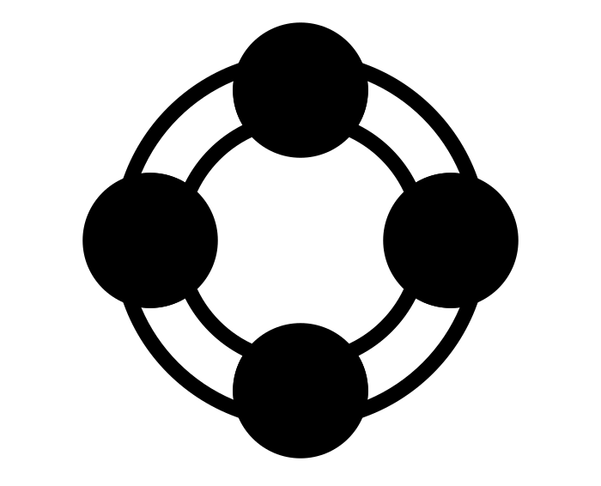
Interviews and workshops revealed that OY and those proximate to them can struggle to understand, discuss and address the injustices
HOW THEY ARE AFFECTED
Understanding
Discussing
Addressing
Many disadvantaged OY do not realize or understand that they are facing structural injustices, believing that their reality is normal and acceptable
In some communities, OY feel unable to openly or explicitly voice some of the injustices (e.g., by caste, religion, sexuality) that they or their peers face due to potential repercussions e.g., arrest, accusations of being politically incorrect
Disadvantaged OY, particularly young women, are often in denial of the need for interventions, believing that they do not have a place in accessing and engaging with specific opportunities
Youth
Employers and other support actors often struggle to break down and conceptualize the issue of ‘structural injustice’, finding the concept overly abstract
In some contexts, local organizations need to be careful when discussing ‘taboo’ topics, while in others some support actors (e.g., governments) simply refuse to openly acknowledge injustices – especially if they are perpetuating them
Given the complexity and multi-faceted nature of structural injustice, supporting non-profits often struggle to identify concrete goals and interventions to pursue to overcome the barriers and challenges
Employers and supporting non-profits
The framework should aim to help disadvantaged OY and support actors understand, discuss, and address issues of structural justice
Sources: Interviews with anchor and global partners; workshop with anchor partners; session with young people

Slide 28
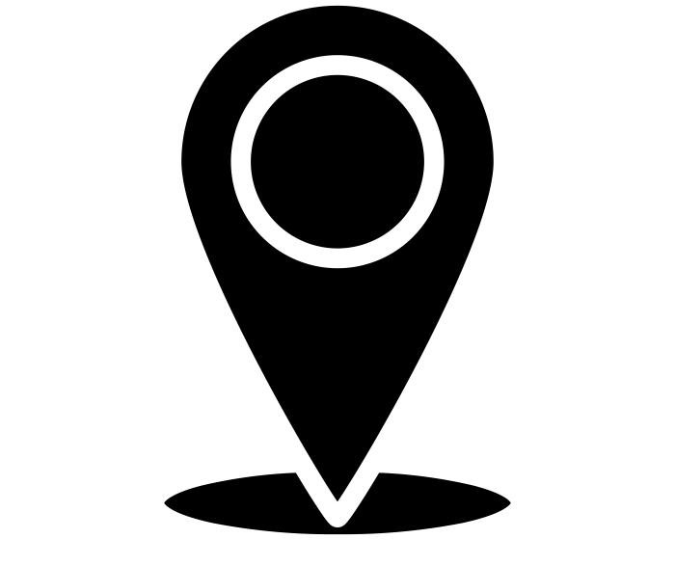
As a result, partners are implementing various solutions to deepen learning and foster dialogue and action (1/2)
Anchor partners
SOLUTIONS
Global partners
Understanding
Discussing
Addressing
Creating safe spaces (e.g., workshops) for ‘discovery’ whereby OY, employers and other support actors can identify where injustices show up in practice
Capturing learnings from active experimentation of solutions
Further research into structural inequities preventing disadvantaged OY in accessing livelihood options and effective strategies to address them
Creating communication channels for OY to represent their problems in public spaces
Shifting mindsets e.g., to make certain topics less taboo
Leveraging/disseminating research to provide specific data to communicate the evidence to policy- and decision-makers
Working with youth and community organizations to develop a shared youth agenda
Empowering disadvantaged OY e.g., through mentorship, connections to opportunities, capacity building of OY ambassadors
Shifting community mindsets on the role of women e.g., via counselling
Strengthening community institutions
Advocacy / awareness campaigns
Influencing policy and/or translating existing policy into action
Developing business case & trainings for employers / financial institutions to engage disadvantaged OY
Overview of solutions underway by anchor partners
A team in Pune conducted home visits to every single OY home to understand experiences of economic discrimination of all social groups. Sao Paulo has developed a data mapping tool/ dashboard to break down injustices by type, social group, and geography
Ramgarh is developing a shared vision to create a shared understanding of goals by drafting missing statements around a structural justice agenda
Sao Paulo is a member of a youth-led advocacy group, Juventudes do Agora, aiming to create and consolidate a “National Policy For and With Youth”
Examples

Slide 29
As a result, partners are implementing various solutions to deepen learning and foster dialogue and action (2/2)
Anchor partners
SOLUTIONS
Global partners
Understanding
Discussing
Addressing
Facilitating dialogue with youth and local organizations within communities to surface the issues that are facing disadvantaged OY in that specific context
Funding research into the structural injustices facing youth in terms of accessing livelihood opportunities
Developing a shared internal understanding of what equity and structural justice means to the organization and its staff
Identifying specific terminology (e.g., equity; diversity, equity & inclusion; structural justice) to anchor around in internal and external conversations
Publicly acknowledging and denouncing the role of global power structures – including within the organization – in perpetuating injustices in the Global South
Global convenings with GOYN members to foster dialogue on experiences of disadvantaged OY
Funding and building the capacity of local non-profits and civil society organizations in working with disadvantaged OY
Developing specific programs aimed at empowering disadvantaged youth to pursue livelihood opportunities
Applying an equity and structural justice lens in internal processes e.g., disaggregated data collection, representation in leadership and staff, integrating diversity metrics in partner selection
Overview of solutions underway by global partners
The Aspen Opportunity Youth Forum (OYF) acknowledges the need to understand context, culture, family history, and deeper historical events (e.g., colonialism) or constructs (e.g., caste systems) that shape injustices today in different contexts
GDI spoke openly at the GOYN Equity Summit 2021 about the power imbalances and systemic issues that continue to exist in global development work
Among other initiatives, Prudential asks partners to collect and analyze data disaggregated by demographic markers (e.g., ethnicity); integrates diversity metrics into the due diligence process when making grants; and holds internal trainings e.g., on asset framing, ethnical storytelling
Examples

Slide 30
These efforts have been designed in a way that increases the agency of disadvantaged OY in creating change
SOLUTIONS
GOYN members look to design solutions that:
Uplift youth voices | Continuously creating the space and means to solicit youth perspectives and center on those in the creation of solutions
Are inclusive | Ensuring that outreach efforts reach and represent all OY, including those that are harder-to-reach and belong to the most marginalized groups
Apply an assets-based lens | Appreciating youth’s lived experience as assets, and looking to build on those assets in future efforts
Promote collective action | Fostering a mindset of collective action among livelihood partners, as opposed to working in siloes

Slide 31
External lessons on applying an equity and structural justice lens: Core learnings
CHAPTER 05
SYNTHESIS
‹#›

Slide 32
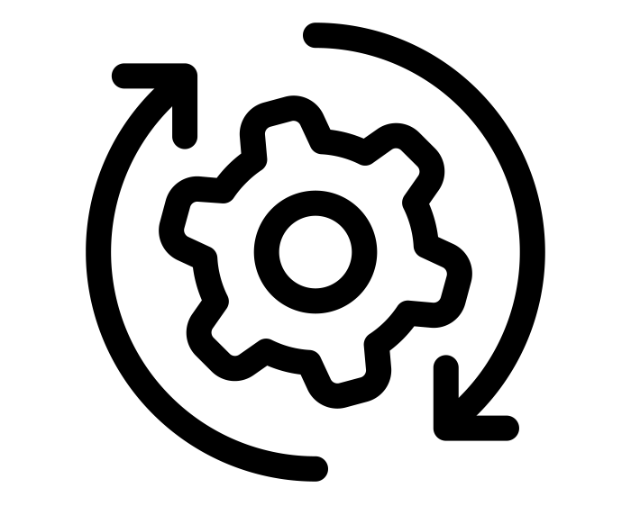
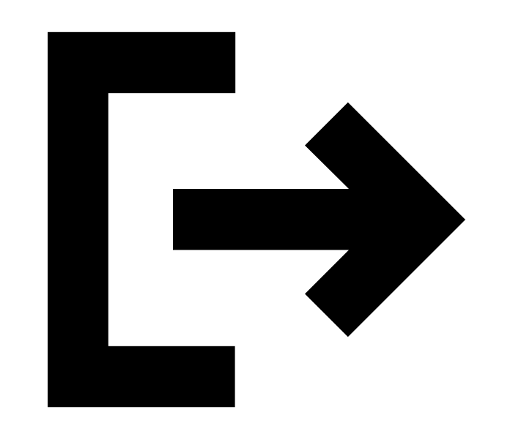
Regardless of the frame used, learnings from external organizations and literature point to opportunities for GOYN to further embed an equity lens in its work
LEARNINGS
GOYN has further scope to:
1
Centre on the most marginalized social groups
2
Ensure that internal processes and systems reflect external equity and structural justice goals
3
Work towards exit, ensuring that OY and partners are equipped to sustain the change over time

Slide 33
Centre on the most marginalized social groups
LESSON 1
Evidence and examples
Lessons for GOYN
Adopting an explicit focus on the most marginalized social groups of OY can enable GOYN to generate impact across all the OY that it works with. Doing so might involve:
Focusing more closely and intently on a smaller subset of OY that have the least access to opportunity, recognizing the benefits this will bring to all OY in the community
Identifying how different markers of disadvantage (e.g., race, gender) intersect to create unique dynamics for these groups
Understanding how the needs and incentives of the most marginalized OY may differ from other groups
What this means for the framework…
In the ‘OY assets and perspectives’ section, the framework should include guiding questions that help partners to:
Actively identify – and draw out the perspectives of – the most marginalized groups of OY, ensuring to surface all dimensions of disadvantage and their intersections
Surface specific incentives and needs of the most marginalized OY in terms of engaging with and owning the changes
Identify the key barriers facing these groups specifically, and inform the subsequent interventions that GOYN and partners should pursue
Evidence of the ‘curb-cut effect’ finds that interventions or reforms focused on improving the lives of the most vulnerable social groups creates outsize benefits to everyone in society
This concept first stemmed from the fact that curb-cuts were originally added to sidewalks to accommodate those in wheelchairs, but subsequently created much broader benefits across society - for those with baby strollers, for bike-riders, for elderly people, and others. In this way, focusing on those most left behind can result in everyone winning
Sources: ILO and Mastercard Foundation, June 2020, “Getting Africa’s youth working. Taking a systems approach to create more & better jobs for young people in sub-Saharan Africa”

Slide 34
Ensure that internal processes and systems reflect external goals around equity and structural justice
LESSON 2
Evidence and examples
Lessons for GOYN
GOYN can institutionalize the equity and structural justice lens in all aspects of its work. This might include:
Providing the tools to support GOYN members and partners in collecting disaggregated OY data e.g., by gender, race, caste, sexual orientation, etc., ensuring that they cover all margins of disadvantage where possible and are applicable to the various data collection methods adopted across communities
Further embedding equity considerations into the criteria for partner selection
Tailoring reporting processes to how partners operate and track progress to reduce the process burden and enable greater focus on pushing for change
What this means for the framework…
The “How we operate” section should include guiding questions around data, MEL, metrics for change, and accountability mechanisms.
The entire framework should be adaptable and transferrable across GOYN’s strategy.
Created a toolkit to help organizations and collaboratives in assessing how far along they are, from color-blind to equity-focused, both internally and externally
Considers the extent to which organizations collect and analyze disaggregated data (e.g., by race), have accountability mechanisms for equity, internal groups working on issues of equity, and more
Race Matters Institute
Developed the OYF Data Use Framework outlining six cross-sector efforts to use data to set strategies, monitor progress and capture impact
This includes the use of OYF Common Measures – which help communities track youth (dis)connection to education and workforce pathways – required to communicate the vision and make the case for the OY movement

Slide 35
Annex: Stakeholder inputs

Slide 36
Stakeholders consulted
We interviewed and/or held a workshop with sixteen GOYN partners
 | Name | Organization | Geography | Engagement method
Global partners | Petula Nash | Catholic Relief Services | Global | Interview, workshop
 | Samuel Diaz | Prudential | Global | Interview
 | Heidi Strawson | Accenture | Global | Interview
 | Steve Patrick | Aspen Institute | Global | Interview
 | Monique Miles | Aspen Institute | Global | Interview
 | Dana Francoise | W.K. Kellogg Foundation | Global | Interview
Anchor partners | Nokubonga Gumbi | Harambee | eThekwini | Interview, workshop
 | Ruchi Mathur | Lighthouse Communities | Pune | Workshop
 | Anish Kumar | TRIF | Ramgarh/Barwani | Workshop
 | Mahmoud Noor | SwahilitPot Hub | Mombasa | Workshop
 | Tere Lanzagorta | YouthBuild Mexico | Mexico City | Workshop
 | Juan Carlos Reyes | Fundación Corona | Bogota | Workshop
 | Natalia Borrero | Fundación Corona | Bogota | Workshop
 | Nilton Clecio | United Way | Sao Paulo | Workshop
 | Flavia | United Way | Sao Paulo | Workshop
 | Jonathan Sales | United Way | Sao Paulo | Workshop
We also held a workshop to hear directly from five young people from Pune, eThekwini, and Mombasa

Slide 37
Synthesis of perspectives shared by stakeholders
Key takeaways from interviews and workshops
Young people
Young people often have to be careful when discussing issues of equity and structural justice; specifically, they cannot openly or explicitly talk about injustices related to caste, religion, sexuality and other identity markers with their family or in public due to potential repercussions (which can include arrest)
They have a strong desire for continued, and deeper, GOYN activity around sensitization and awareness-building – in both formal (e.g., education in schools) and informal (e.g., street plays) settings
They underscored the importance of ensuring representation of marginalized social groups of youth in GOYN structures and events
Anchor partners
Through the framework, anchor partners wish to pursue activities that (i) create the space for discussion and human to human connection; (ii) start to move the needle e.g., advocacy, lobbying, sensitization campaigns, supported by tools/guides to help work with governments and youth across various structural issues; and (iii) enable them to identify the specific challenges to double down on in different contexts
They would also value greater accountability mechanisms such as tools, metrics, or systems to track progress against their “North star”, based on the evidence of what works
When discussing these issues, they would like to continue to focus on asset-based language, avoiding terms like "marginalized" or "excluded“, and avoiding – or being clearer – on terms like "structural injustice", "equity versus equality", "structural versus systemic", etc.
Global partners
Global partners pointed to the usefulness of having common terminology/understanding of equity and structural justice as a network that can be adapted to how communities understand and speak to these issues, recognizing the criticality of the history and impacts of events like colonialism, slavery, etc., in terms of defining and understanding these issues in context
In terms of how global partners see themselves using the framework, they mentioned (i) creating direction and focus (i.e., the ‘goalposts’) in their own work on equity & structural justice; (ii) informing how they ‘show up’ and discuss issues of equity and structural justice with new and existing partners in a way that is authentic, builds trust and mobilizes further dialogue and action; and (iii) informing their own internal processes and ways of working to better embed an equity & structural justice lens – recognizing the need to ‘walk the talk’
They also emphasized that the framework should not be prescriptive, avoiding ‘absolutes’ where possible recognizing that there can be no ‘one-size-fits-all’ solution to issues of equity and structural justice, particularly in different places
Finally, they underscored the need for organizations to openly talk about their own role or culpability in creating or contributing to injustices

