Slide 1
GOYN TANGA
FINANCIAL INCLUSION IN TANGA YOUTH

Slide 2
TangaYetu
Part of Our City Initiative - Foundation Botnar.
Support selected cities around the world to implement coordinated programs that leverage digital technologies and Artificial Intelligence (AI) and transform them into places where young people’s wellbeing and opportunity is secured.

Slide 3
About GOYN Tanga
GOYN Tanga is an approach that aims to create an environment for Tanga Yetu to reach youth based on the opportunities available in Tanga
HD-Consulting Associate is the Anchor partner in the Implementation

Slide 4
Pathways
ENTREPRENEURSHIP SAVING AND CREDITS PATHWAY
ART AND HERITAGE PATHWAY
DATA AND TECHNOLOGY
WELDING AND ENGINEERING PATHWAY

Slide 5
Agenda
Need for savings & entrepreneurship
Details about the intervention
Future goals
Testimonials
Notes:
Example: To spotlight the Tanga Savings initiative that provides young people the opportunity, to invest in themselves, identify and build business solutions in their communities towards economic mobility. We will talk about

Slide 6
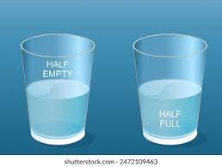
Why Saving and Entrepreneurship?

Slide 7
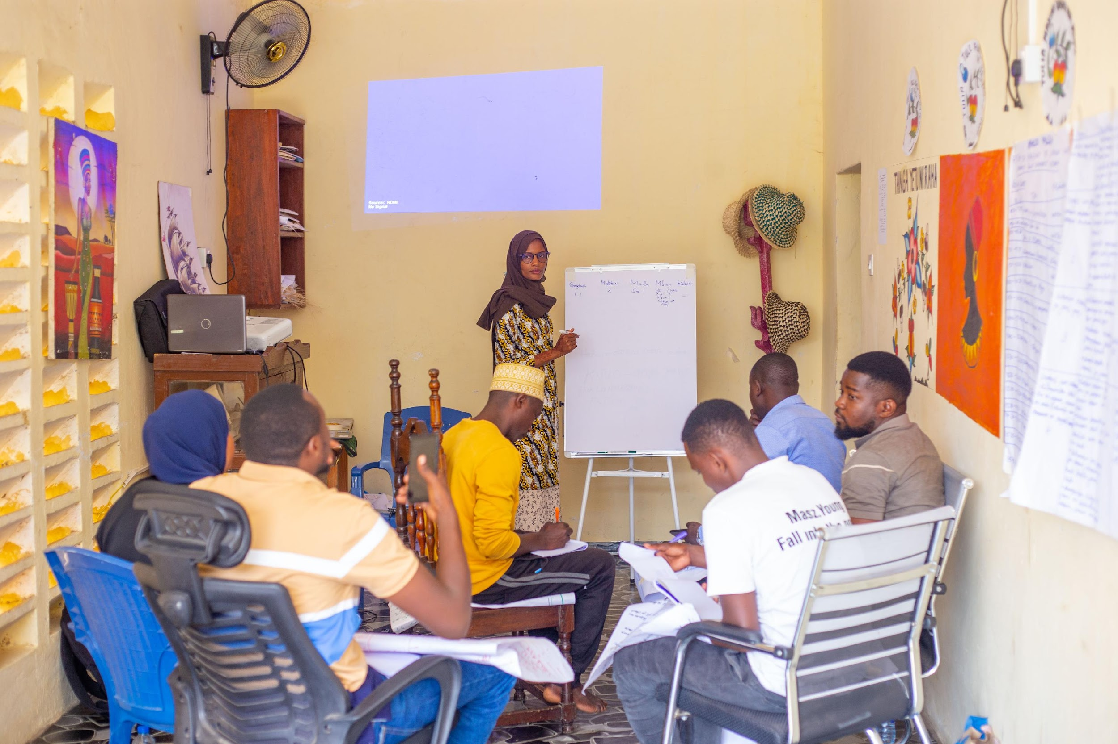
Cont….
Lack
Lack business and entrepreneurship skills
Access
Access to finance
Lack
Ability to recognize economic opportunity
Access
Access to information
Lack
Lack of networking Opportunities

Slide 8
GOYN Tanga’s Solution:
Mindset and saving groups
The Mindset and Saving Group Program is designed to help individuals build better financial habits through collective saving.
Participants come together in small groups and agree to contribute a set amount of money on a regular basis.

Slide 9
Details about the Training
Objectives of Mindset Training for Behavioral Change Purpose
Transformation in Attitude and Awareness: Shift youth mindsets to embrace personal growth, community engagement, and sustainable practices. Cultivate self-reliance, entrepreneurial thinking, and active participation in decision-making.
Youth Mobilization Strategy, Community Outreach: Engage communities directly to identify youth interested in mindset transformation.
Curriculum Overview, Structure: 20 modules categorized into three key areas, Entrepreneurial skills, innovation and Culture: Understanding values, heritage, and identity.
Financial Literacy, Money management and building economic resilience.
Trainers' Expertise, am among the youth who were empowered to become trainers for this program, and to ensure that young people access opportunities, we have empowered 10 youth, including 6 from YAG and 4 from OYs, to become facilitators of mindset training.

Slide 10
Details about the “Savings Groups”
These groups are formed by 10-30 members who know each other and live in the same community, with common goals, they meet once a week and they are using a strong metal box for saving
About the Constitution The structure used to create the constitution is one, and it is a guide from TCC. However, the groups may differ in their goals depending on the vision of the specific group, and fundamentally, the members are the ones who make decisions by electing their leadership.

Slide 11
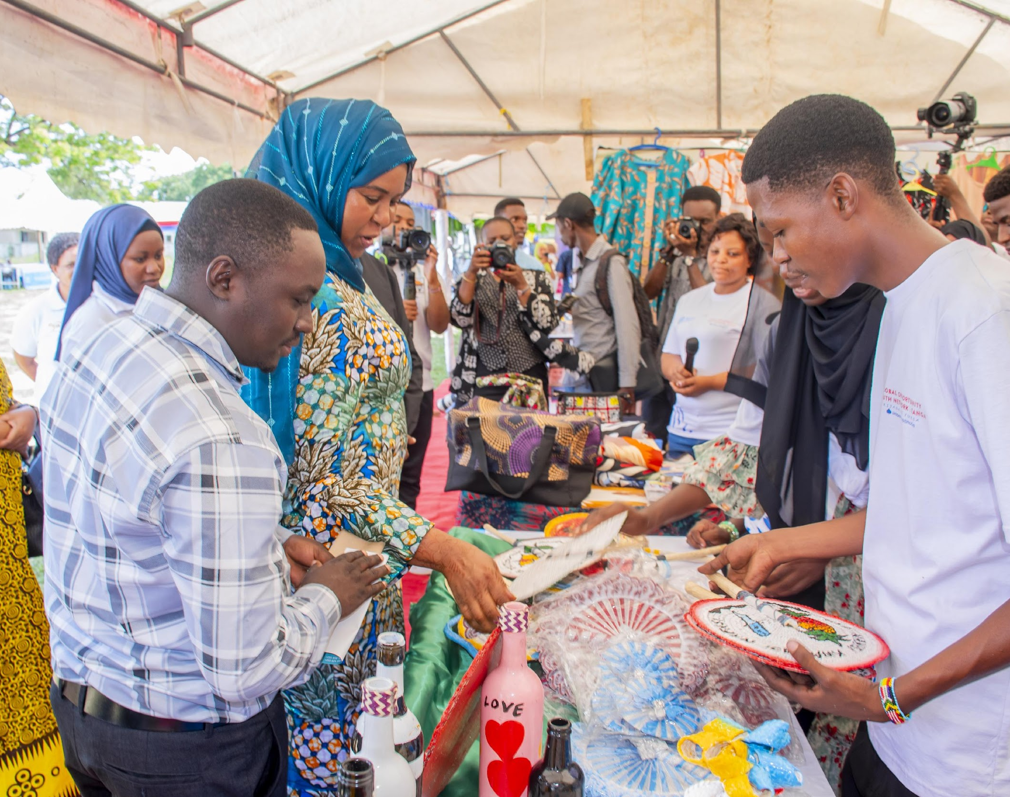
Entrepreneurship support
Supporting 112 youth to start business eg. Making liquid soap, Renting carpet and selling clothes
Link 12 entrepreneurs to business improvement training e.g. Mawimbi program which the pitching session
Supporting access to market through exhibition participation eg, Science and technology exhibition, Youth International day and GOYN annual youth forum

Slide 12
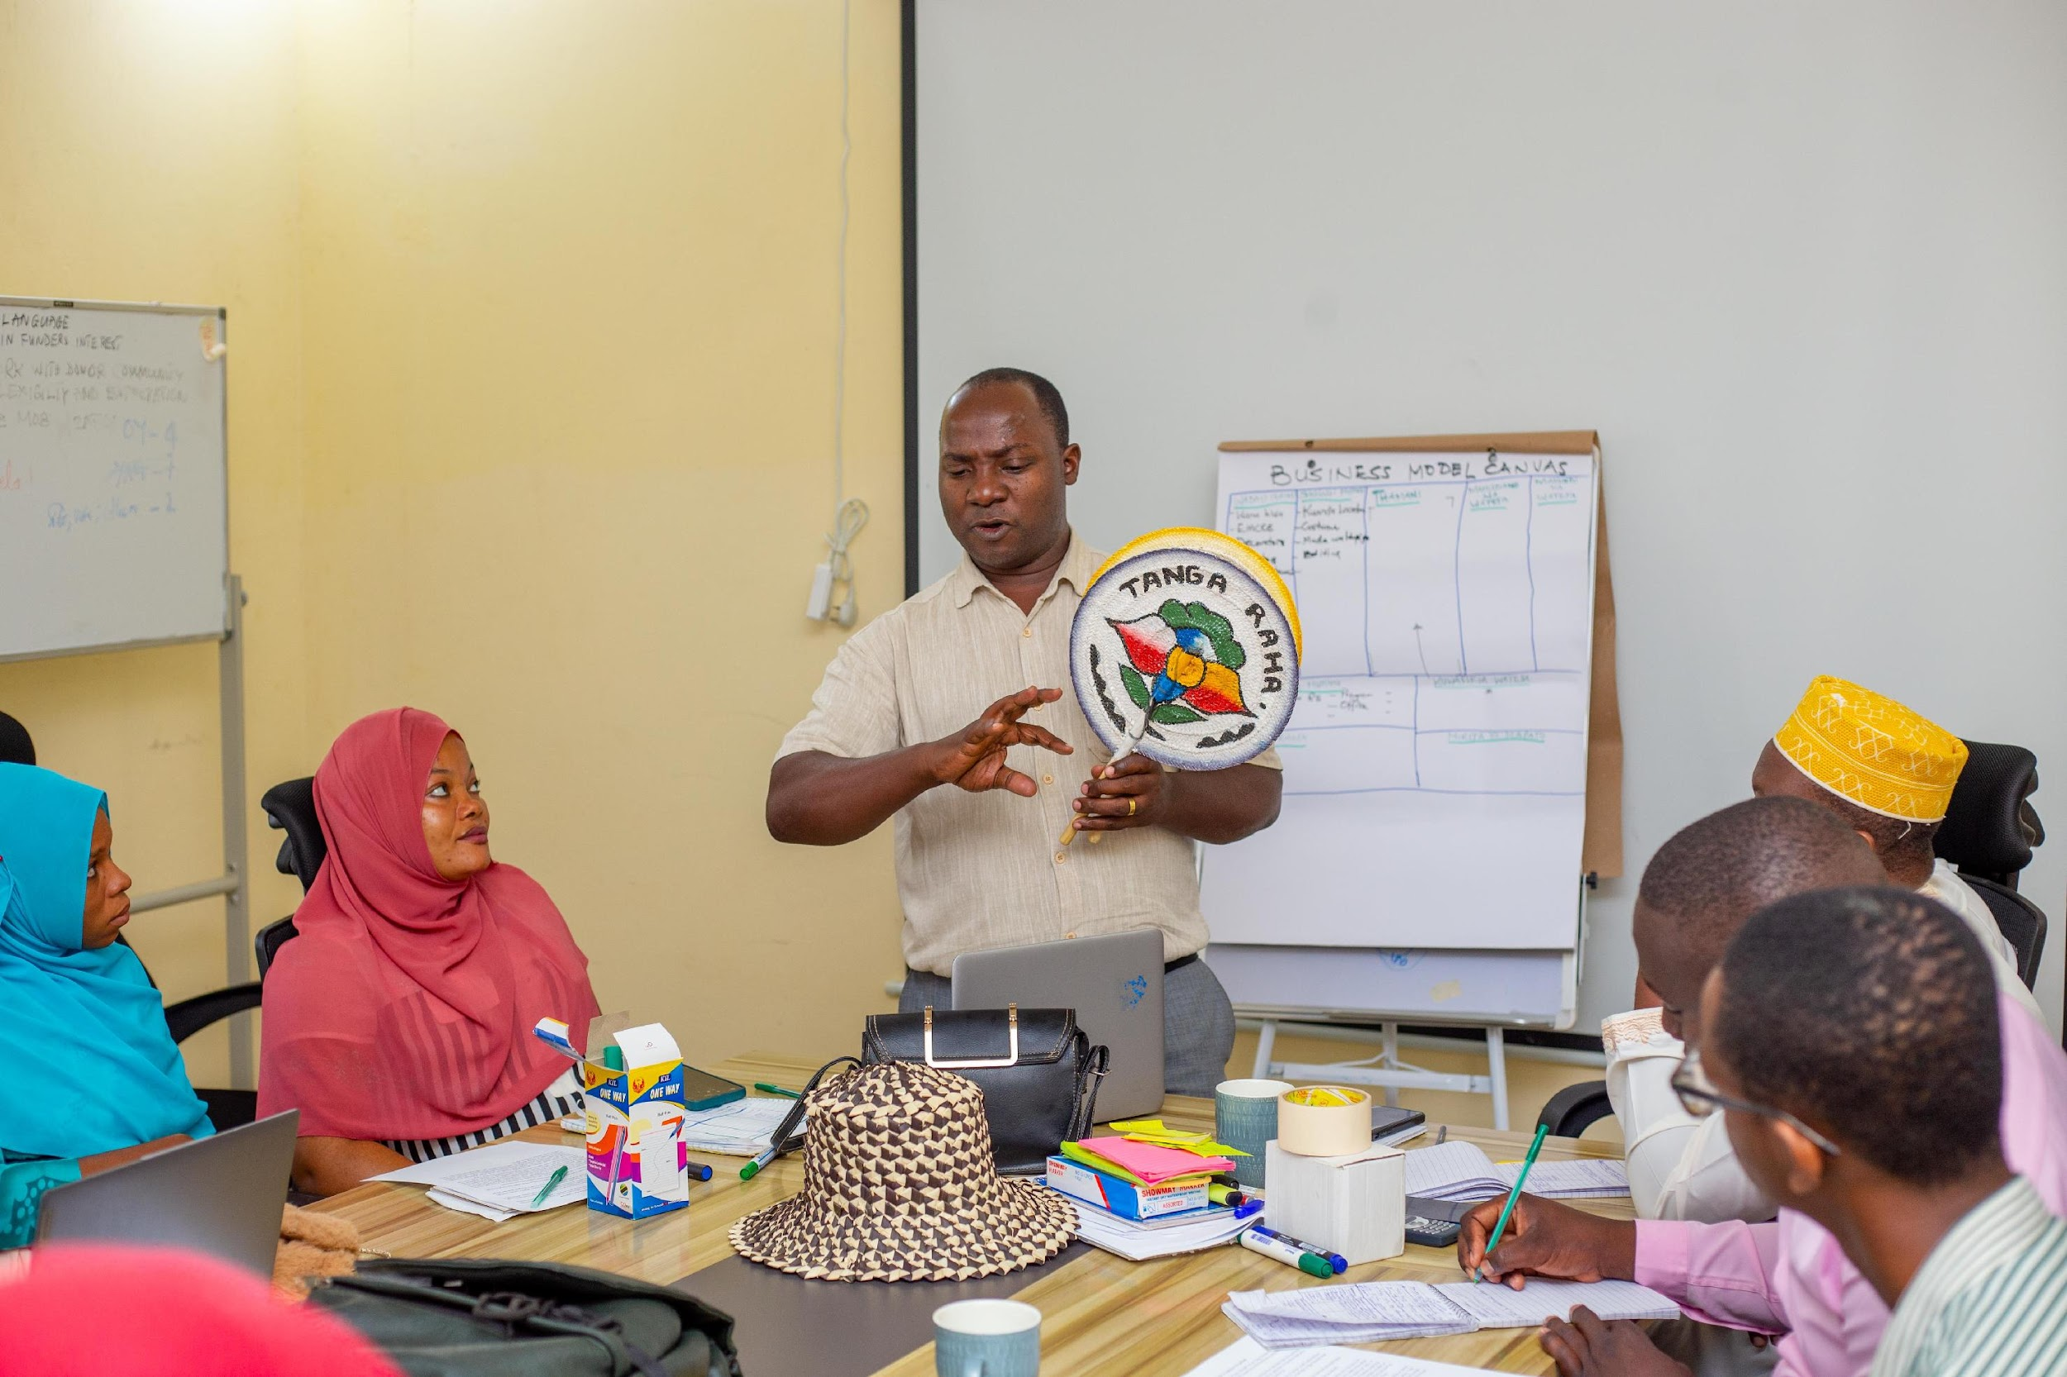
Phases of support provided by the anchor partner

Slide 13
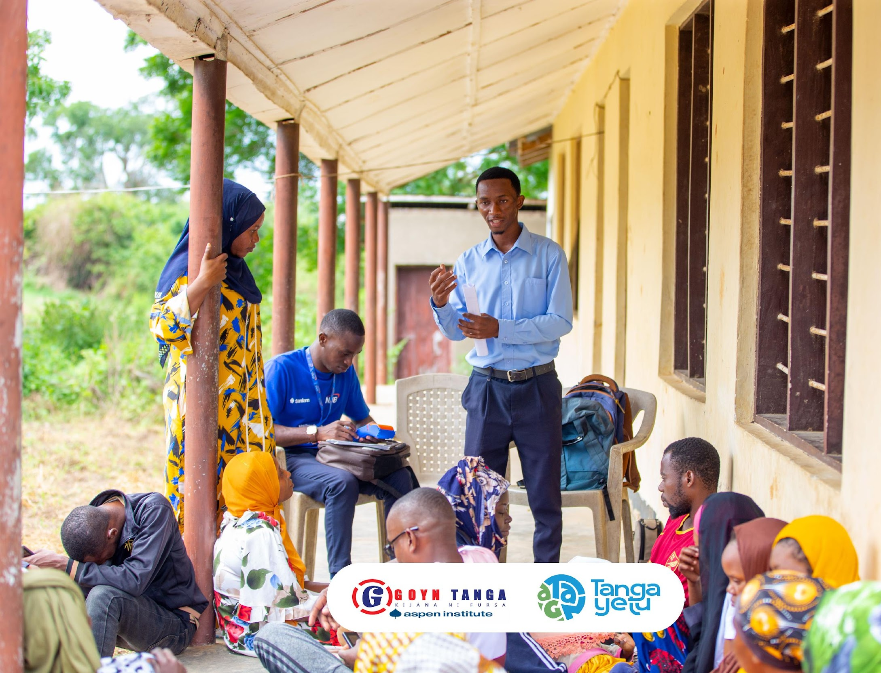
Impact of the mindset training and the saving groups
To have 1o mindset facilitators .
Establishing 16 saving groups with the total saving 24,653,181Tshs
Support 10 business group access to finance. (70% receive the loans)
3 saving groups youth started businesses

Slide 14
The future goals
Up grading the skills
Financial Literacy training
Psychosocial empowerment program for youth
Connect youth with relevant stakeholders. Example Tanga Yetu, Tanga City councils, SIDO, ENABEL, Training institutions, and Financial intuitions
Scaling saving groups to microfinance
Facilitate on going support and mentorship and Organize career fear for job placement
Organize network and partnership event such as Exhibitions, workshops and exchange programs

Slide 15
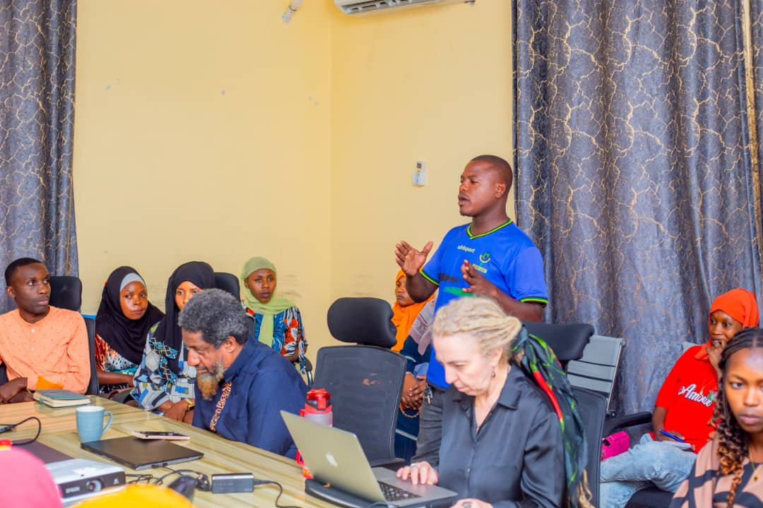
Testimonials
Saidi Mohamed, a 33 years old entrepreneur living in Nguvumali, used to struggle with saving money in an organized way. This often led to unnecessary spending. However, after joining a training program on mindset change and financial management. He realized that he could save money if he adopted proper principles.
He decided to join a savings group and has since reduced unnecessary expenses to focus on saving. Currently, his group has 32 members, and together they have saved over 1.5 million Tanzanian Shillings.

Slide 16
TESTIMONIALS
Emma Pius I am a 29 year old resident of Mzizima Ward in Tanga City. I did not know where to start and had lost hope, I was not engaged in any activity. When I heard about the opportunity for training from GOYN, I joined the 5-day mindset change training. After the training, I realized that I could start with the little I had. I joined a savings group with others, and we began saving and borrowed TZS 50,000 to our own group to pay a teacher to train us on making liquid soap.
Now we have a project of producing toilet liquid soap and Shampoo we are looking forward to gain more skills in branding and marketing through GOYN to improve our business and increase our marketing strategy

Slide 17
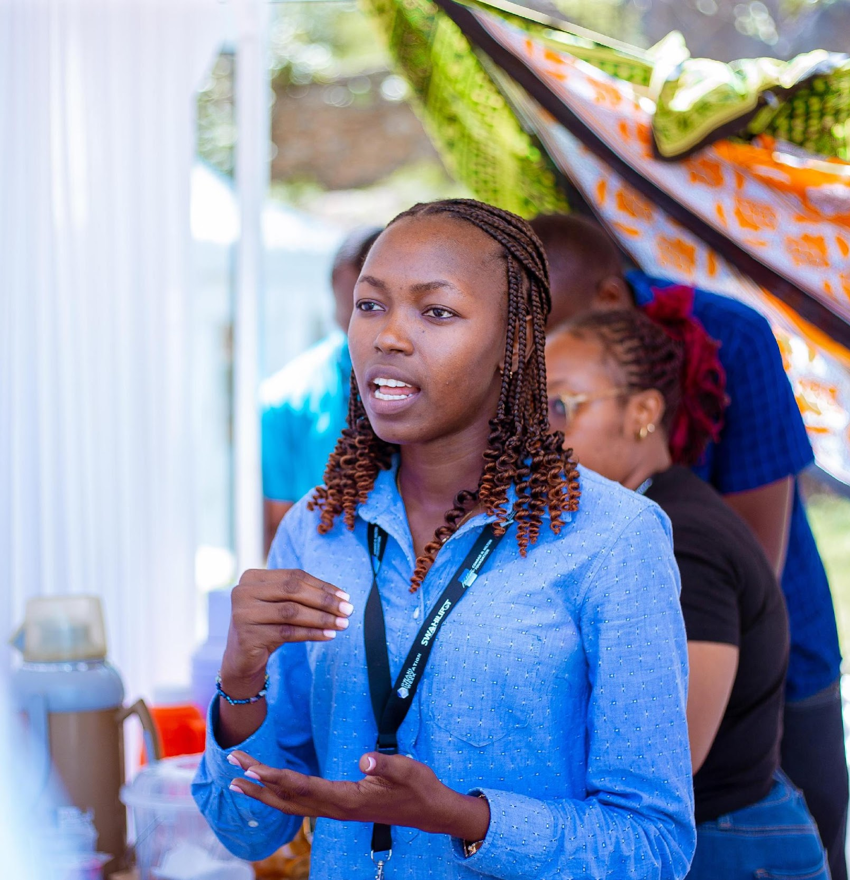
Testimonials
Elizabeth Gerald, a 24 years old Ilive in Sahare, at Mzingani Ward, am entrepreneur running a small education-based business. (YAG), I had the opportunity to join a Mindset Change class and became a member of a savings group. I was later selected as one of 10 youth to participate in a Training of Trainers (ToT) program.
Elizabeth has since become an effective facilitator of Mindset Change training and savings group management. Together, we have reached over 400 young people and established 16 savings groups.
Elizabeth participate on international and local events through GOYN, such as Pwani Innovation week – Mombasa, and GOYN global convening – India.
She become GOYN Swahili – English Translator

Slide 18
THANK YOU
FATMA MWINJUMA
Entrepreneurship Saving and Credits Pathway Lead
+255 684 558910
mfatma@hdca.co.tz

